Slide 1
PHYS 304: Lecture 16 (Intro to) Quantum Mechanics
Sept-Dec 2021 Edition
Jeff Young
brimacombe Rm 278, young@phas.ubc.ca

Slide 2
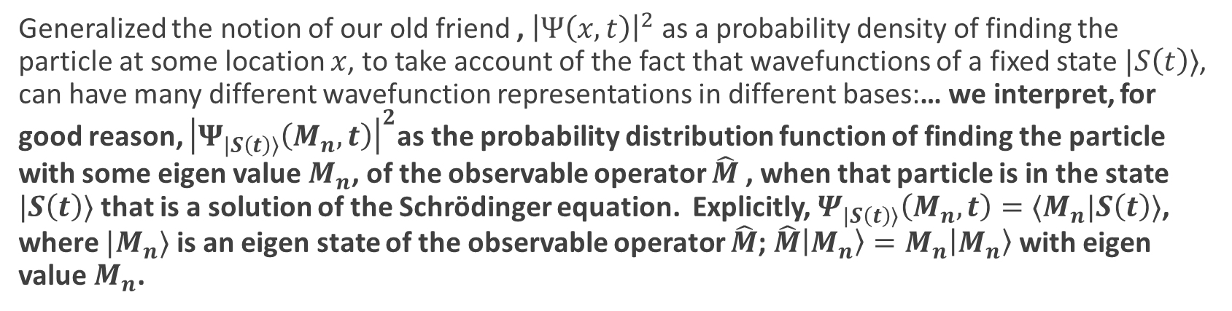
Review of key points from last lecture
Saw several more examples of how to transform equations in Dirac notation into equations involving wavefunctions and differential/integral operators in any viable basis.
Ended up deriving a series of basis transformation equations that could be used to convert the wavefunction of some state in one basis, into the wavefunction of the same state expressed in a different basis.
Generalized the notion of our old friend , ${\left|Ψ\left(x,t\right)\right|}^{2}$ as a probability density of finding the particle at some location $x$, to take account of the fact that wavefunctions of a fixed state $|S\left(t\right)⟩$, can have many different wavefunction representations in different bases:… we interpret, for good reason, ${\left|Ψ_{|S\left(t\right)⟩}\left(M_{n},t\right)\right|}^{2}$as the probability distribution function of finding the particle with some eigen value $M_{n}$, of the observable operator $\hat{M}$, when that particle is in the state $|S\left(t\right)⟩$that is a solution of the Schrödinger equation. Explicitly, $Ψ_{|S\left(t\right)⟩}\left(M_{n},t\right)=⟨M_{n}|S\left(t\right)⟩$, where $|M_{n}⟩$ is an eigen state of the observable operator $\hat{M}$; $\hat{M}\left|M_{n}\right\rangle =M_{n}\left|M_{n}\right\rangle$ with eigen value $M_{n}$.

Slide 3
Today
Elaborate slightly on the last point from Lecture #15
Derive the “Generalized Uncertainty Relationship” between the variances of any two physical observables.
Discuss some implications of this uncertainty principle.

Slide 4
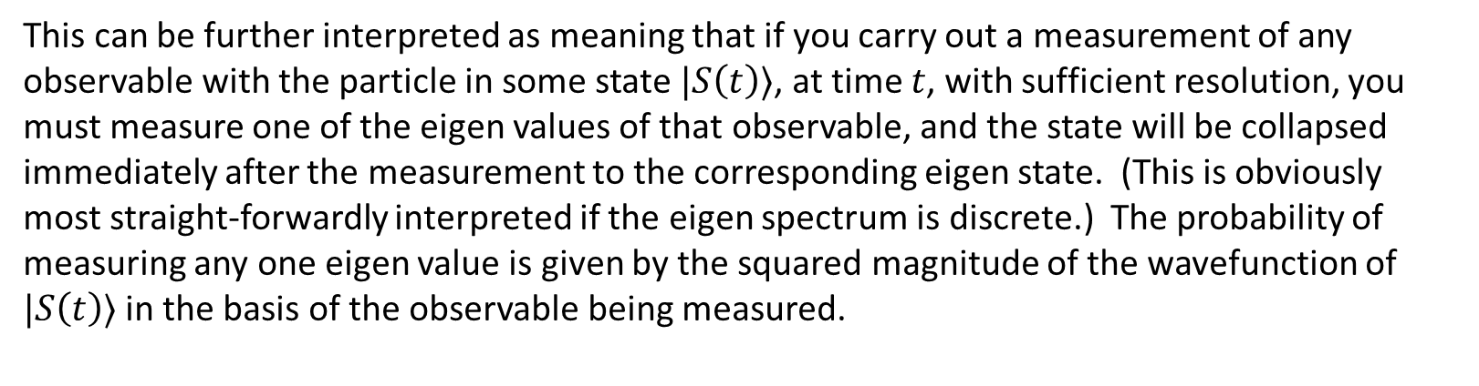
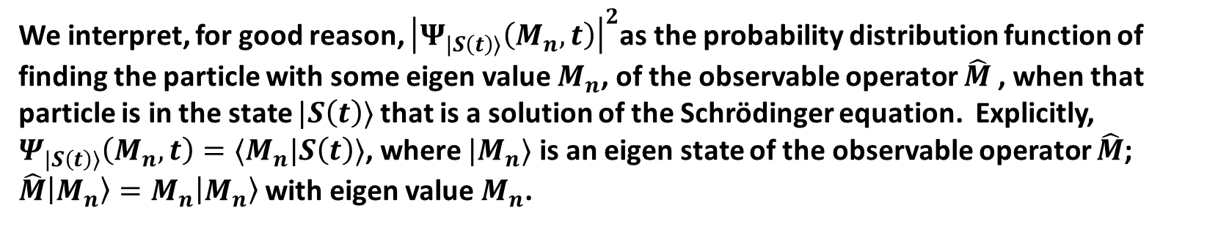
The Generalized Statistical Interpretation in Quantum Mechanics
We interpret, for good reason, ${\left|Ψ_{|S\left(t\right)⟩}\left(M_{n},t\right)\right|}^{2}$as the probability distribution function of finding the particle with some eigen value $M_{n}$, of the observable operator $\hat{M}$, when that particle is in the state $|S\left(t\right)⟩$that is a solution of the Schrödinger equation. Explicitly, $Ψ_{|S\left(t\right)⟩}\left(M_{n},t\right)=⟨M_{n}|S\left(t\right)⟩$, where $|M_{n}⟩$ is an eigen state of the observable operator $\hat{M}$; $\hat{M}\left|M_{n}\right\rangle =M_{n}\left|M_{n}\right\rangle$ with eigen value $M_{n}$.
This can be further interpreted as meaning that if you carry out a measurement of any observable with the particle in some state $|S\left(t\right)⟩$, at time $t$, with sufficient resolution, you must measure one of the eigen values of that observable, and the state will be collapsed immediately after the measurement to the corresponding eigen state. (This is obviously most straight-forwardly interpreted if the eigen spectrum is discrete.) The probability of measuring any one eigen value is given by the squared magnitude of the wavefunction of $|S\left(t\right)⟩$ in the basis of the observable being measured.

Slide 5
The Generalized Statistical Interpretation
What would be one way of preparing a state with zero variance in some observable?
If some other observable shared the same set of eigenstates, what would be the variance of that other observable after the state is prepared as above?
Notes:
Put it into an eigen state
Zero, from the generalized statistical interpretation.
If in a particular eigenstate, then measuring that observable of which it is an eigenstate, must result in obtaining that eigen value

Slide 6
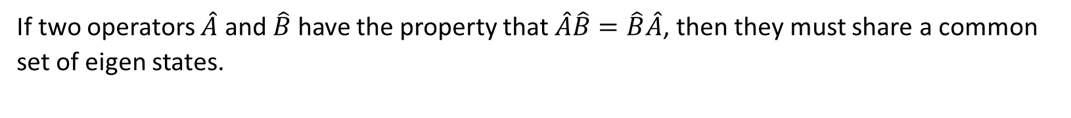
The Generalized Statistical Interpretation
If two operators $\hat{A}$ and $\hat{B}$ have the property that $\hat{A}\hat{B}=\hat{B}\hat{A}$, then they must share a common set of eigen states.
Does this tell us what the eigen value of the observable B is in this eigen state of A?
What does this imply for the precision with which one could measure the observables corresponding to two commuting operators when the particle is in one of their shared eigen states?
Notes:
Discuss ensemble interpretation, not two distinct measurements of same state at same time.

Slide 7
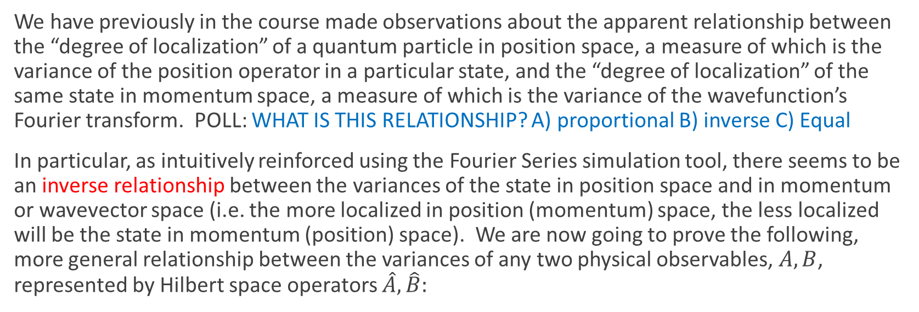
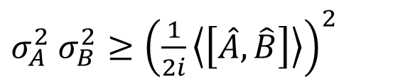
The Generalized Uncertainty Relation
We have previously in the course made observations about the apparent relationship between the “degree of localization” of a quantum particle in position space, a measure of which is the variance of the position operator in a particular state, and the “degree of localization” of the same state in momentum space, a measure of which is the variance of the wavefunction’s Fourier transform. POLL: WHAT IS THIS RELATIONSHIP? A) proportional B) inverse C) Equal
In particular, as intuitively reinforced using the Fourier Series simulation tool, there seems to be an inverse relationship between the variances of the state in position space and in momentum or wavevector space (i.e. the more localized in position (momentum) space, the less localized will be the state in momentum (position) space). We are now going to prove the following, more general relationship between the variances of any two physical observables, $A,B$, represented by Hilbert space operators $\hat{A},\hat{B}:$
$σ_{A}^{2}$ $σ_{B}^{2}≥{\left(\frac{1}{2i}\left\langle \left[\hat{A}, \hat{B}\right]\right\rangle \right)}^{2}$

Slide 8
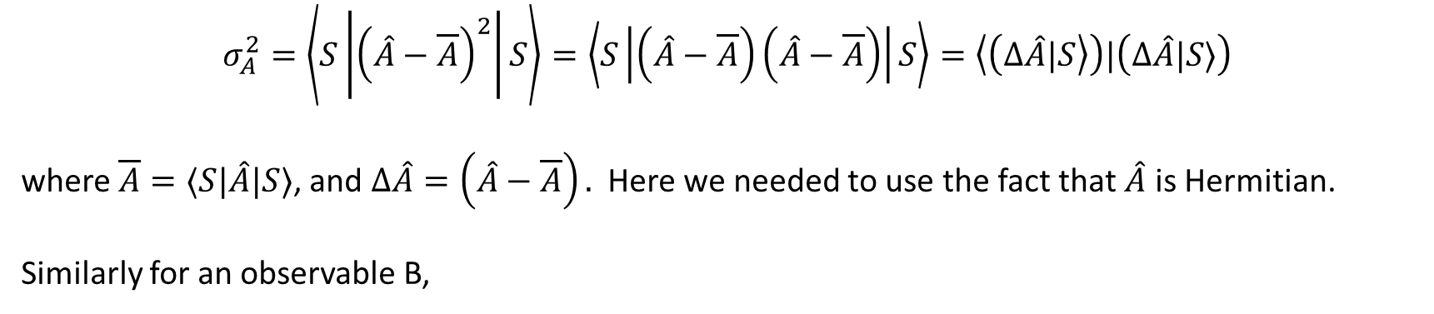
The Generalized Uncertainty Relation : Derivation
$$σ_{A}^{2}=\left\langle S\left|{\left(\hat{A}−\overline{A}\right)}^{2}\right|S\right\rangle =\left\langle S\left|\left(\hat{A}−\overline{A}\right)\left(\hat{A}−\overline{A}\right)\right|S\right\rangle =\left\langle \left(Δ\hat{A}|S\right\rangle \right)|\left(Δ\hat{A}|S⟩\right)$$
where $\overline{A}=⟨S|\hat{A}|S⟩$, and $Δ\hat{A}=\left(\hat{A}−\overline{A}\right).$ Here we needed to use the fact that $\hat{A}$ is Hermitian.
Similarly for an observable B,
$$σ_{B}^{2}=\left\langle S\left|{\left(\hat{B}−\overline{B}\right)}^{2}\right|S\right\rangle =\left\langle S\left|(\hat{B}−\overline{B})(\hat{B}−\overline{B})\right|S\right\rangle =\left\langle \left(Δ\hat{B}|S\right\rangle \right)|\left(Δ\hat{B}|S⟩\right)$$

Slide 9
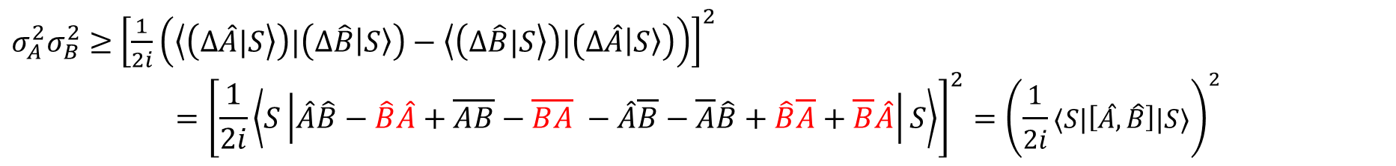

The Generalized Uncertainty Relation : Derivation
$$σ_{A}^{2}σ_{B}^{2}=⟨ΔAS|ΔAS⟩⟨ΔBS|ΔBS⟩$$
From the Schwartz inequality of linear algebra,
$$\left\langle \left(Δ\hat{A}|S\right\rangle \right)\left|\left(Δ\hat{A}\left|S\right\rangle \right)\left\langle \left(Δ\hat{B}|S\right\rangle \right)\right|\left(Δ\hat{B}\left|S\right\rangle \right)≥{\left|\left\langle \left(Δ\hat{A}|S\right\rangle \right)|\left(Δ\hat{B}\left|S\right\rangle \right)\right|}^{2}$$
Now$\left\langle \left(Δ\hat{A}|S\right\rangle \right)|\left(Δ\hat{B}\left|S\right\rangle \right)$ is some complex number, and the squared magnitude of any complex number is always greater than the squared magnitude of its imaginary part, hence,
$σ_{A}^{2}σ_{B}^{2}≥$ ${\left[\frac{1}{2i}\left(\left\langle \left(Δ\hat{A}|S\right\rangle \right)|\left(Δ\hat{B}\left|S\right\rangle \right)−\left\langle \left(Δ\hat{B}|S\right\rangle \right)|\left(Δ\hat{A}\left|S\right\rangle \right)\right)\right]}^{2}$
$$={\left[\frac{1}{2i}\left\langle S\left|\hat{A}\hat{B}−\hat{B}\hat{A}+\overline{A}\overline{B}−\overline{B}\overline{A} −\hat{A}\overline{B}−\overline{A}\hat{B}+\hat{B}\overline{A}+\overline{B}\hat{A}\right|S\right\rangle \right]}^{2}={\left(\frac{1}{2i}⟨S|\left[\hat{A},\hat{B}\right]|S⟩\right)}^{2}$$
Notes:
Sketch 2D vector equivalent

Slide 10
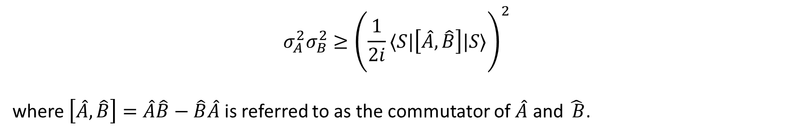
The Generalized Uncertainty Relation : Derivation
$$σ_{A}^{2}σ_{B}^{2}≥{\left(\frac{1}{2i}⟨S|\left[\hat{A},\hat{B}\right]|S⟩\right)}^{2}$$
where $\left[\hat{A},\hat{B}\right]=\hat{A}\hat{B}−\hat{B}\hat{A}$ is referred to as the commutator of $\hat{A}$ and $\hat{ B}$.
Thus

Slide 11





Exercise:
What is the operator $[\hat{x},\hat{p}]$? (does it simplify?)
- How would you formulate the solution to this question? i.e. what equation needs to be solved?
- How do you actually go about solving the equation?
Notes:
Given them 3 minutes to work on it.
Hand write solution

Slide 12







Slide 13



Slide 14
Exercise
Derive the uncertainty principle prediction for the relationship between the variances of the energy and momentum operators for a free particle.
Notes:
Get them to do it… given them 3 minutes with hint to use momentum basis

Slide 15
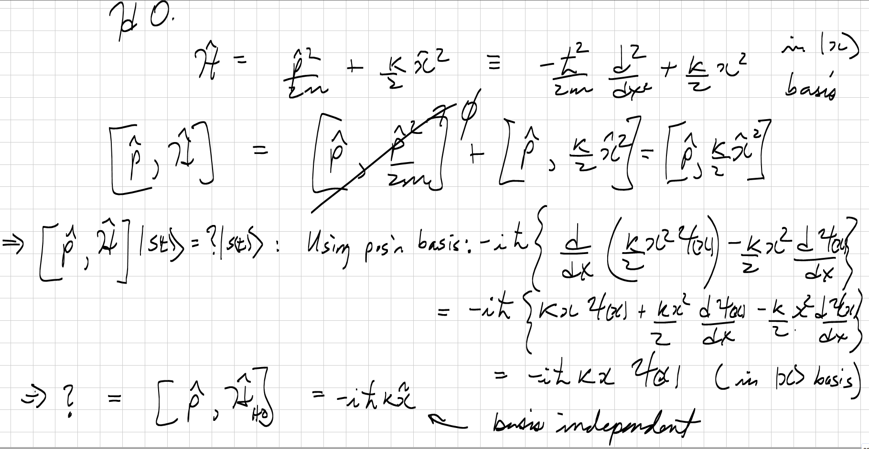

Exercise
Derive the uncertainty principle prediction for the relationship between the variances of the energy and momentum operators for a particle in a harmonic oscillator potential.

Slide 16
Observations
What sense can you make of i) the differences between these two results, and ii) the fact that the parameter that characterizes the minimum value of the product of uncertainties in one case depends on <x>?

